Slide 6
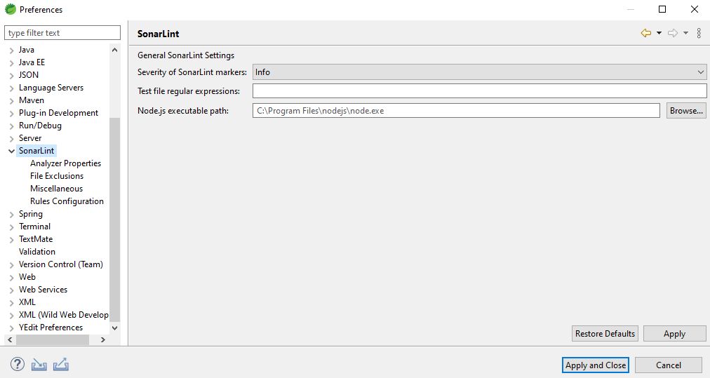
Configure SonarLint

Slide 8

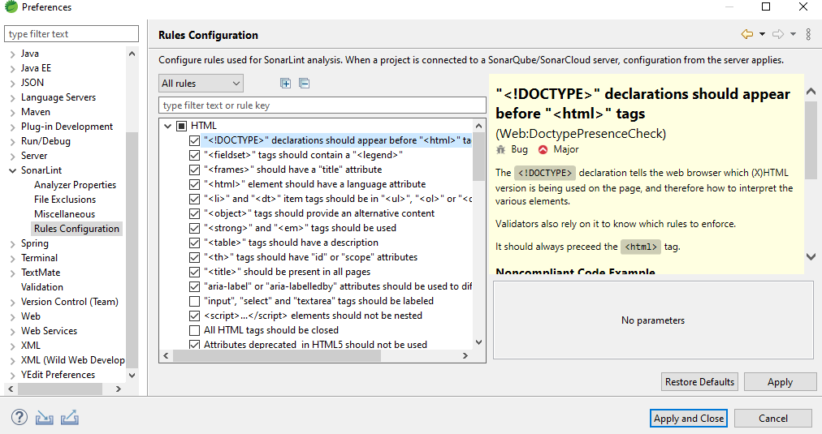

Slide 9
Sonar Lint Rule Description

